Slide 1
Versioning for Data-Centric Engineering
A workshop on the uses and benefits of versioning to help with versioning in DCE
Notes:
Introduce versioning as a general concept

Slide 2
The problem:
Final_this_oneFINAL_v3.py
Script evolution is an iterative process
Versioning software’s such as git provides a solution that can track and manage changes
Notes:
Explain the problem and ask for examples

Slide 3
What is Versioning
Track file changes over time
Records who changed what, when and why
Maintains single source of truth
Replaces manual file-duplication backups
Notes:
Give a general explanation of versioning and explain how it can fix the problem

Slide 4
Where is versioning used
Whenever you use Ctrl-Z
Word etc.
Solidworks Cloud, onShape
Notes:
Ask for any examples of where people know of it

Slide 5
Why do I want versioning?
Cloud backup
Easy experimentation through branching
Instant recovery from breaking bugs
Clear accountability and team collaboration
Notes:
Talk through the uses of it and the reasons to try and get people to realise that the cost of setting it up is worth it

Slide 6

Git vs Github
A local software
Used to track history and file changes
Takes snapshots (commits)
A web-based hosting platform
Enables safe collaboration in real time
Acts as a central backup
Notes:
Explain the difference and highlight where to use one or the other

Slide 7
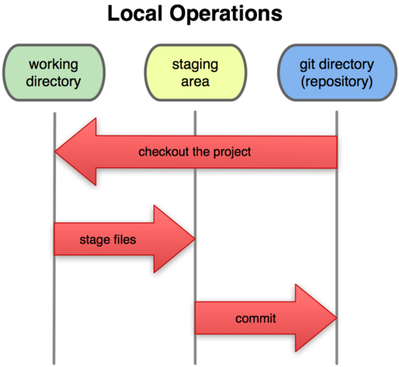
How does Git work
You work as normal in your folder
You can stage “good” changes to be committed
You can commit your code to your repo for it to be used
Notes:
If you want go onto your files and make a bad edit and then revert it

Slide 8

What is a snapshot/commit
A recorded state of an entire project at a moment in time
Each commit comes with a message explaining what happened
A continuous linked chain of history
Notes:
Set the stage and explain what a snapshot/commit it to help people understand the background of git

Slide 9
Git CLI Functions
Git init
  Ran in the root folder of a project
Git add .
  The . adds all changes into the current commit but this can be file specific
Git commit –m “<message>”
  This is how you take a “snapshot” of the code
Git push/pull
  Use this to sync your code with remote servers like github or gitlabs
Notes:
Go through these, breaking down the commands

Slide 10
Commit Messages
Type | When to use it | Example
Feat | A new feature or capability added to the codebase | Feat(auth): add OAuth2 support
Fix | A bug fix | Fix(solver): resolve matrix convergence crash
Docs | Documentation-only changes (README, wiki, comments) | Docs: update setup instructions to README
Refactor | A code change that neither fixes a bug or adds a feature | Refactor: simplify mesh generation loop
Perf | A code change that improves performance | Perf: vectorize distance calculation algorithm
Chore | Routine tasks, build tracking or dependency updates | Chore: bump numpy version to 1.26
Test | Changes made to tests | Test: add unit tests for boundary conditions
CI | Changes made to CI config files and scripts | Ci: fix GitHub actions workflow syntax
<type>[optional scope]: <description>
[optional body]
[optional footer(s)]
Notes:
Give people some examples and get them to work out the commit messages

Slide 11
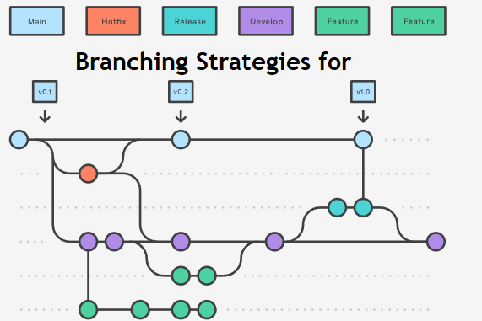
Branching
Branching creates a safe, parallel workspace in your project where you can experiment with new code or features without breaking your main, working version.
Git branch <name>
  Create a branch to work
Git branch
  See all branches
Git merge
  Merge your changes to another branch
Notes:
Explain branching both for teams and personal uses

Slide 12
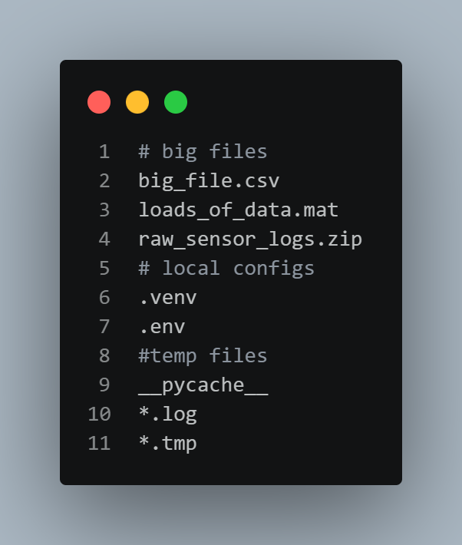
What is .gitignore
Not everything needs to be tracked in git
Files above 100MB should be avoided
Large or unnecessary files shouldn’t be included

Slide 13
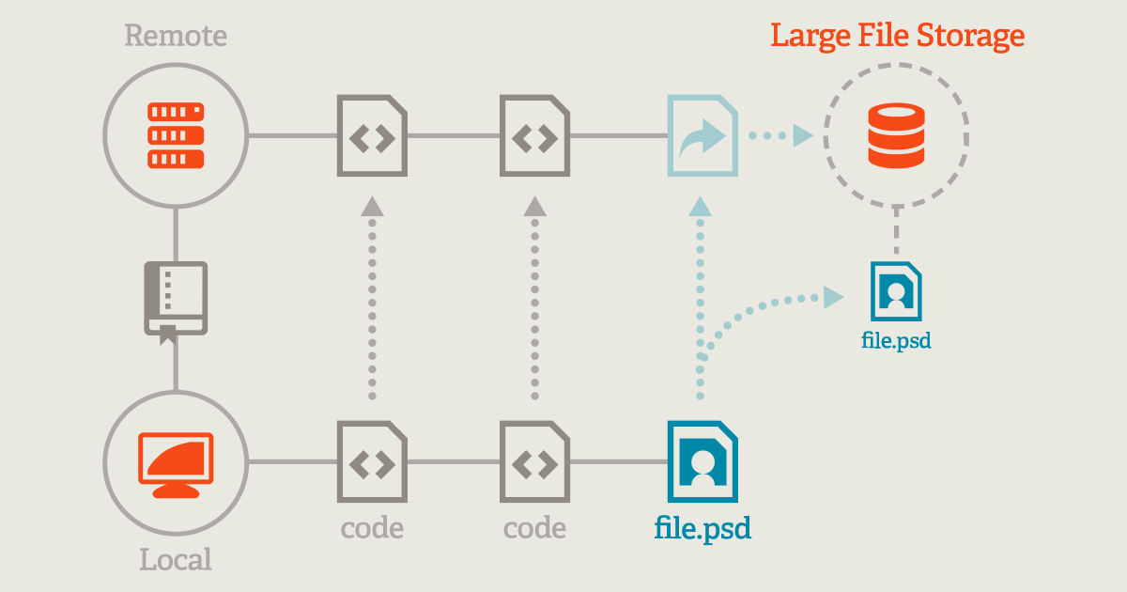
Git Large File Storage (LFS)
Git LFS swaps heavy files in your local project folder with tiny 130-byte text metadata pointers.
When pushing your work, the actual binary gets redirected straight to LFS storage servers, bypassing Git's core history.
Notes:
Exokainb uses of this in DCE, get people to talk through examples etc

Slide 14
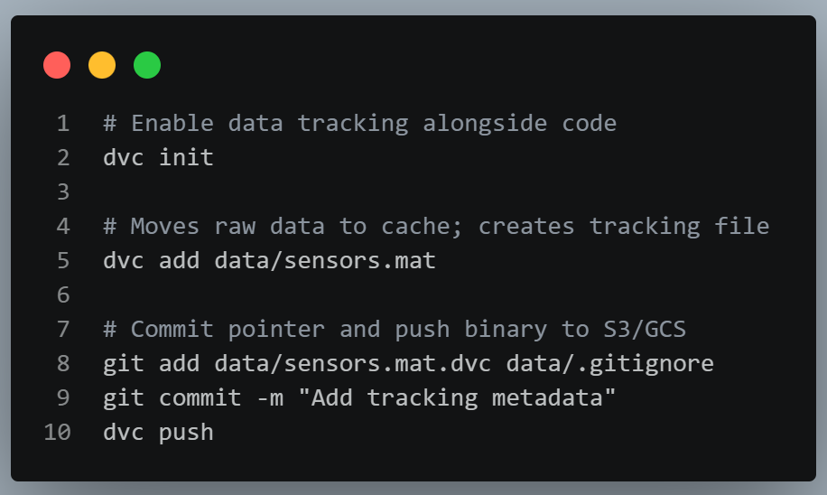
Data Version Control (DVC)
DVC tracks massive datasets and neural network weights by generating tiny human-readable tracked .dvc metafiles.
The actual multi-gigabyte binaries are seamlessly pushed to central cloud buckets (S3, Google Cloud Storage, Azure).
Notes:
Explain DVC and PDM for use in CAD too

Slide 15
LFS vs DVC
Feature | Git LFS | DVC
Primary use | Large files (binaries) | Datasets, models, pipelines
Cloud agnostic | Requires LFS server | Works with S3, Azure, etc
Pipeline support | None | Strong dependency tracking
Complexity | Set and forget | Additional ClI tool management

Slide 16


